Slide 1
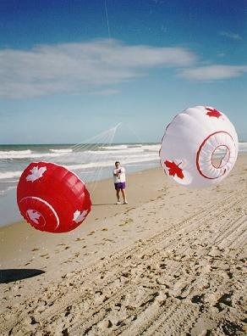
4ft. BOL by Arthur Dibble of White Horse Kite Flyers
These plans are based on a design by Ed Hummel and are available at:- https://www.kiteplans.org/planos/4foot/4foot.html
Make sure you read his instructions before you start using my modifications.
The following notes are on the way I have put mine together.
Canada Bols courtesy Carlos Simoes

Slide 2
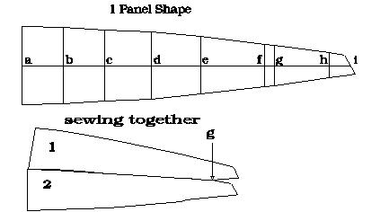
Directions:
Draw a pattern on cardboard using the plan. fig #1(panel shape) and the following chart.
Points on figure #1) a,b,c,d,e,f,g,h,i
Distance from leading edge (inches)
a = 0, b = 4.0, c = 8.0, d = 12.4, e = 17.2, f = 23.4, g = 24.3, h = 29.6, i = 31.6
Width of panel (inches)
a = 7.6, b = 7.4, c = 7.0, d = 6.5, e = 5.6, f = 4.2, g = 3.9, h = 2.5, i = 1.9
note: The angled end is 2.1 inches long and the longer edge is 1 inch greater than the short edge. The point last point, 1.9 inches is on the centre line like the rest of the points in the chart and is a vertical height.

Slide 3
Hot cut 20 pieces of rip-stop nylon. In the pictured examples balloon quality nylon was used. (It is an advantage to live near the only hot air balloon manufacturer in Canada.) It is best to have the grain of the material run down the length of the panel but it is not necessary. (After all, this is a windsock and some stretch is not a disaster.
Sew the first piece to the second from the start of the vent (point g) toward the leading edge of the bol keeping all the sloped ends pointing the same direction. Note that this leaves the narrow end of the panel hanging loose from the 3.9" width back to the angled end. (see fig #2, sewing together)
Continue to sew the panels together until all 20 panels are sewn side by side in a ring. Since my panels were hot cut I just overlapped the material and sewed them once. After spinning for many hours they still have not started to fray. I did overlap them in a direction so that when they rubbed each other or the ground, they would not catch the edge. On larger bols (or baskets as the Americans call them) I did a proper hem.
I hot cut a strip of nylon about 2" wide and 12.56’ (4’ x 3.14) long. Fold it down the center and sew it around the leading edge. Over lap the end when you get all the way around by about an 1" or 2". Again if you would like, you can fold the edge under so that no raw edges are exposed but use a strip about 2.5" wide.
To close the vents on the trailing edge use a strip of nylon about 2" wide. Start enclosing the trailing edge in the center of one of the 2.1" angled edges. When you get near the edge fit the next panel into the "V" shaped strip with the longest edge to the outside. (the wind wants it there too) I overlap the 2 panels by about 0.25".
Cut 20 lengths of 30# to 50# line to 9’. With a large needle sew the line through the leading edge where the panels overlap. There will be 4 layers of material to go through. Gather the 20 lines and attach a strong swivel. It is often a good idea to use 2 or 3 swivels, one after the other, so that if one jams the other one will keep you moving.

Slide 4
These bols are modeled after the windsocks that Bobby Anderson flies. He calls them baskets because they have the vents in the trailing edge. Bols have the vents in the leading edge.
Even these bols are only 4’ in diameter they have a strong pull. When I attach 2 of them to a kite line they almost always pull the line down to the ground because of the drag.
2 of them designed to rotate in opposite directions and attached to the same point on a kite line or anchor will roll on each other and give a beautiful display. To get them to rotate in opposite directions, just flip the pattern over so that the angled ends point the opposite way or when you are finished the entire project push the swivel and bridle through the center of the bol and out the back. If flown this way you should use a minimum of 3 swivels. (one for each bol and one that these 2 are attached to, to form a "Y" shape.
The shape of this design is half a sphere.
You can fly them on a 100’ line if there is heavier wind and a lot of space. Wear your gloves. They can reach a maximum angle of 40 degrees but constantly bounce around with no directional stability. After all, they are not kites.
By Ed Hummel

Slide 5
The first task is to make a cutting template. I used corrugated cardboard and this worked fine for hot cutting 4. I wanted to do a seam to join sections together so added ¼ inch to each side. I also added 1inch to the bottom(A) to fold over the leading edge reinforcing tape. The edges get a bit wavy but this does not matter too much, if you are using seam rather than flat over lapping, as they will be inside and not obvious. For more durable template with solid edges I would transfer the design on to hardboard or similar.

Slide 6
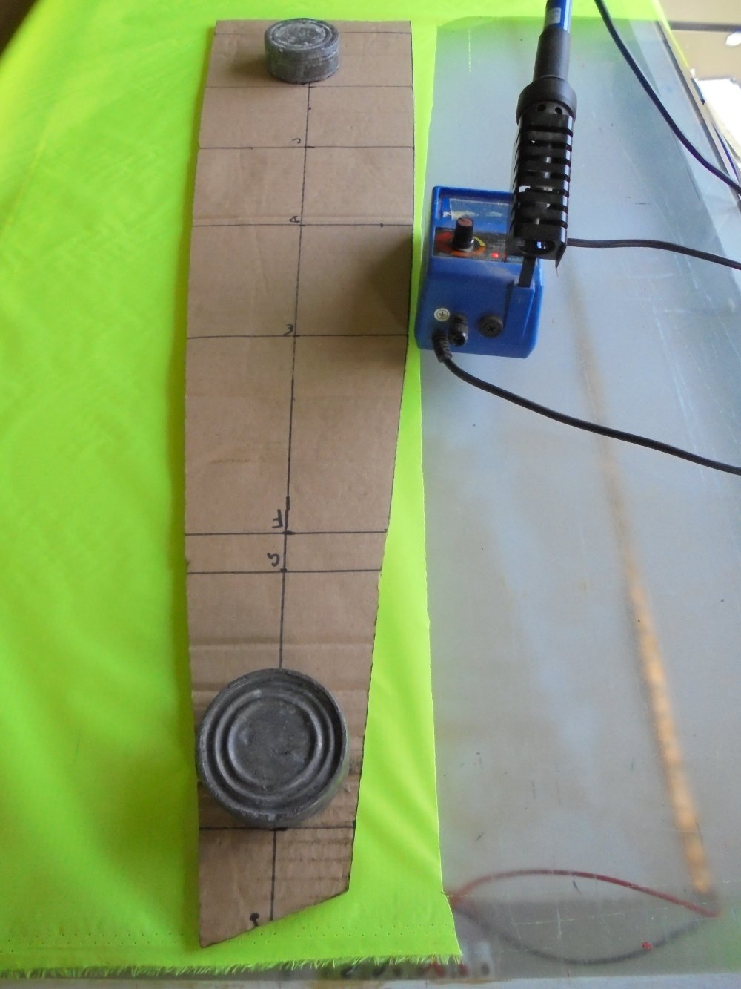
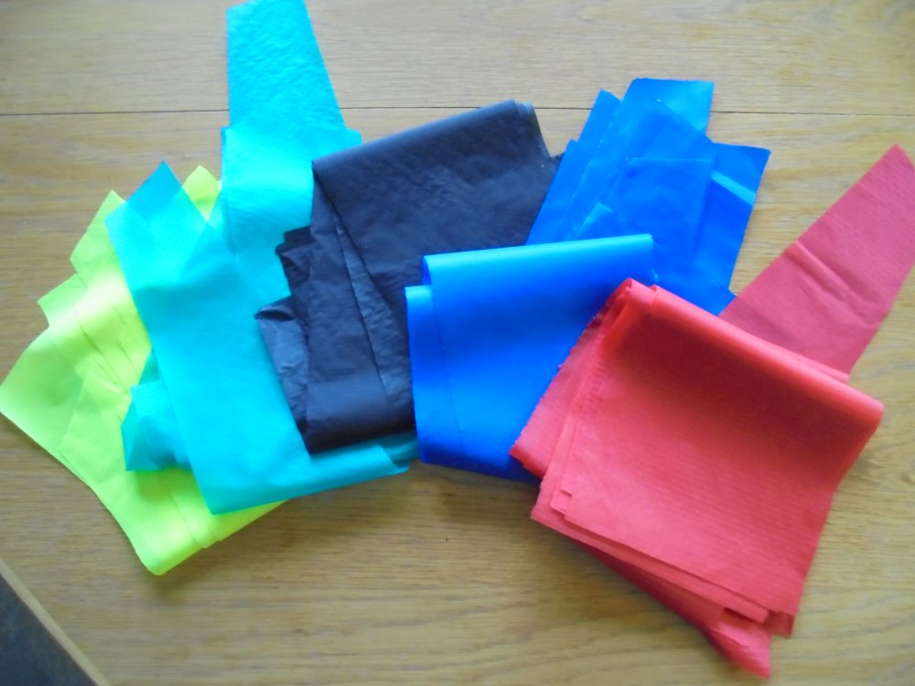
Hot cut 20 sections using your preferred tools and method. Do not turn over the template between sections so that you always have the same side of the material showing. Mark the “G” spot on both sides of the material. If you are adding lettering it is probably best done at this point.

Slide 7
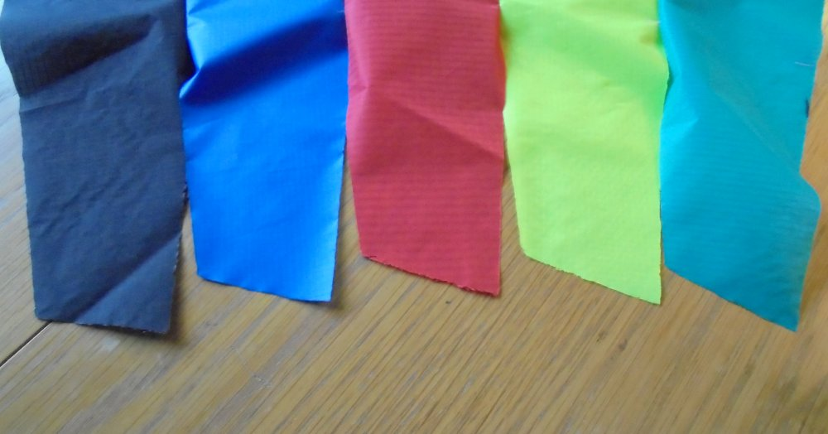
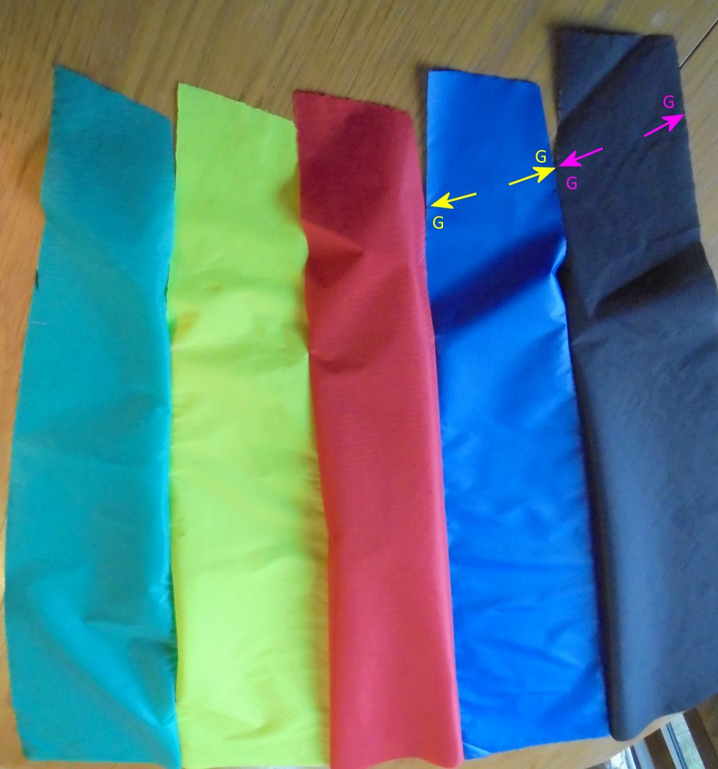
Follow Ed Hummel’s instructions about assembling the bol. Start sewing the panels together being careful to align the “G” spot on the short side of one panel with long side of the next. Start at “G” and sew towards the leading edge.
This is one place where my construction diverges as I lay the pieces back to back and sew a seam at ¼ inch.
If you are using graphics it is easier to join 4 or 5 sections and add your graphics before joining these together as there is less material to get under the arm of your sewing machine.

Slide 8
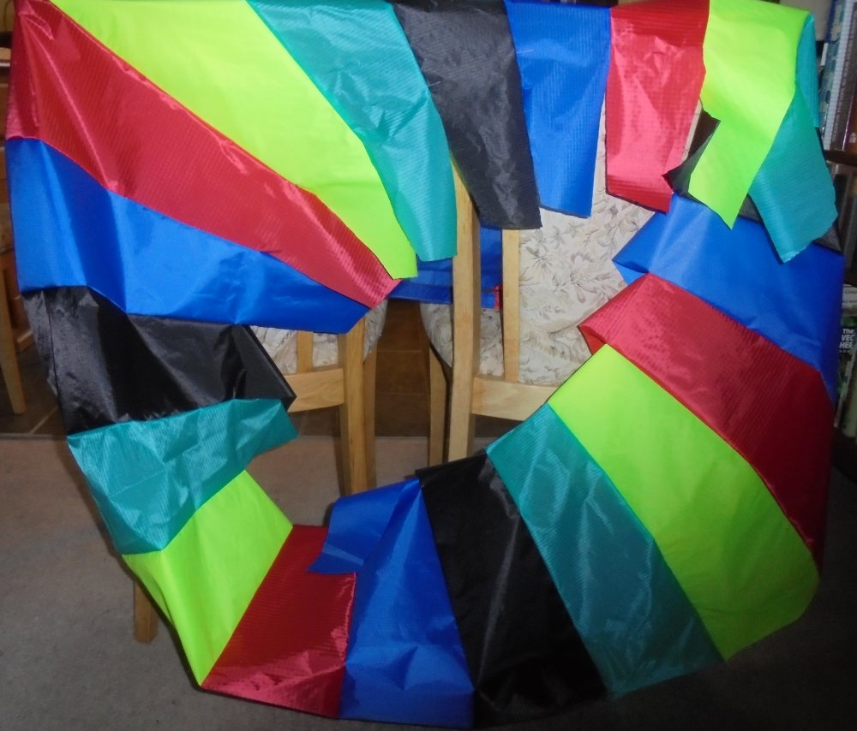
Continue sewing sections together until you have all 20 joined. Being careful not to get a twist join the first to last sections. You should then have a complete ring with the trailing edges hanging loose.

Slide 9
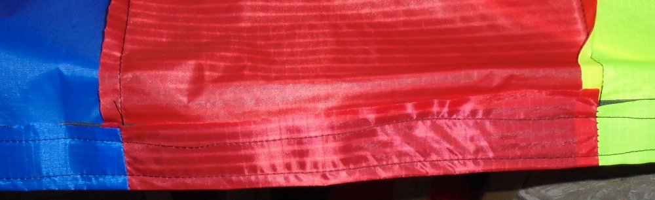
Using a 1 inch wide dacron tape lay it over the leading edge and fold inwards using the extra length on ripstop allowed in the modified template. Sew all the way round the leading edge and overlap the start and finish by about 3 inches. Sew a second seam close to the outer edge.

Slide 10
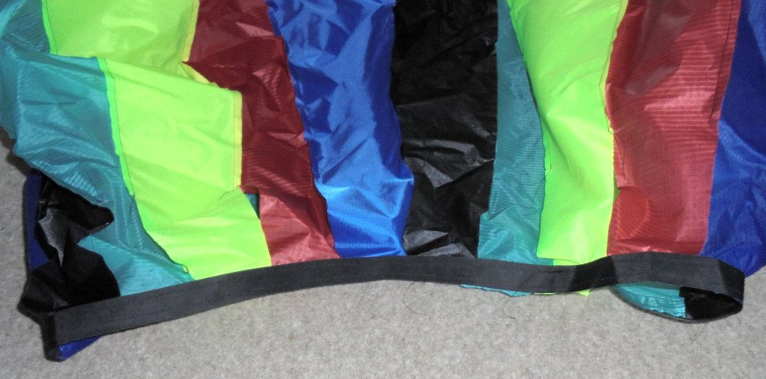
With the bol inside-out add another strip of Dacron to the trailing edge overlapping the sections by ¼ inch and making sure the longer section is always on the outside.

Slide 11
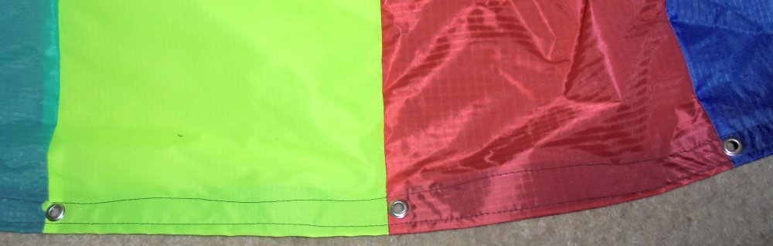
Turn the bol the right way out and punch holes at each seam along the leading edge. Fit an eyelet in each hole. I used ⅜ inch but ¼ would be fine. It is better if you can get the eyelets with backing washers for the inside as these give a better grip.

Slide 12
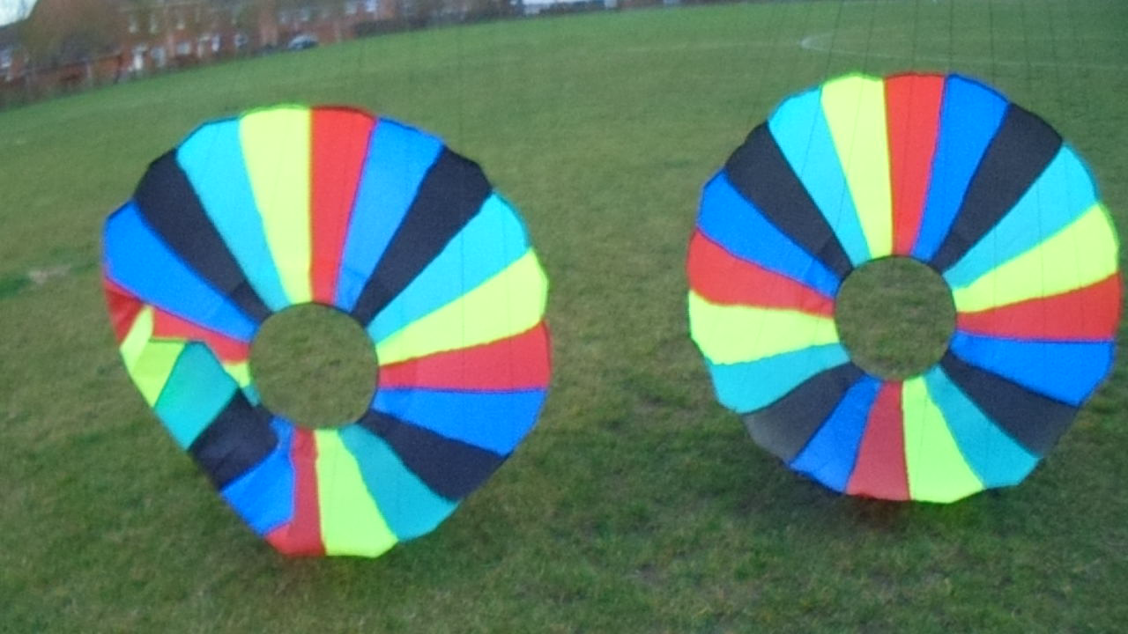
Cut 20 lengths of line 10ft long. Use your own preference of line 25kg or heavier. I used 100lb spectra but this was very thin and difficult to work with. Next time I will try 1.18mm polyester. Pass one end of each line through an eyelet and secure firmly with a knot and adhesive or heat seal. Now either make a loop in the other end of each line, making sure each line is the same length, and fit to a shackle, or line up all leading edge eyelets gather all lines together and tie in an overhand loop. With the spectra lines I did the latter and heat sealed the final knot.
Fit one or more swivels and a carabiner for easy changing of anchor system. This can be just a padded wrist strap or in a good wind, up to 100ft of line.

